Slide 1


Mastering User Input in React Native
A comprehensive guide to handling user interactions in React Native applications. Learn essential techniques for touch events, text inputs, and form validation to create responsive mobile experiences.

Slide 2

What are Touch Events?
Definition
Gestures vs. Touch Events
Touch events are user interactions via screen touches. They form the foundation of mobile app interactivity.
Touch events are raw inputs. Gestures are interpreted patterns like pinch or swipe.
Common Touch Actions
Tap, double tap, long press, swipe, and pinch. Each serves different interaction purposes.

Slide 3




Basic Touch Handling in React Native
Touchable Components
Visual Feedback
Good touch handling includes visual cues. Users should see their touches registered.
React Native provides specialized components that respond to touch input with appropriate feedback.
Platform Considerations
Touch handling may differ between iOS and Android. Consider platform-specific behaviors.

Slide 4




TouchableOpacity Component
Press Down
User touches the component. The opacity begins decreasing.
Hold
Component remains at reduced opacity while pressed.
Release
User lifts finger. Opacity returns to normal. Action triggers.

Slide 5
TouchableOpacity: Example
Implementation
import React from 'react';
import { TouchableOpacity, Text, Alert, StyleSheet } from 'react-native';
const SimpleButton = () => (
<TouchableOpacity
style={styles.button}
onPress={() => Alert.alert('Pressed!')}
activeOpacity={0.6}
>
<Text style={styles.buttonText}>Press Me</Text>
</TouchableOpacity>
);
export default SimpleButton;
TouchableOpacity wraps any component to make it respond to touches with opacity feedback.
The onPress prop takes a function that executes when the touch completes.
const styles = StyleSheet.create({
button: {
backgroundColor: '#007BFF',
padding: 12,
borderRadius: 8,
alignItems: 'center',
},
buttonText: {
color: '#FFF',
fontSize: 16,
},
});

Slide 6



TouchableHighlight Component
User taps element
Touch detected on component
Background changes
Underlay color becomes visible
Action triggers
onPress function executes

Slide 7
TouchableHighlight: Example
Key Properties
import React from 'react';
import { View, Text, TouchableHighlight, Alert, StyleSheet } from 'react-native';
const HighlightButton = () => {
const handlePress = () => {
Alert.alert('Button Pressed!');
};
return (
<View style={styles.container}>
<TouchableHighlight
style={styles.button}
underlayColor="#0056b3" // Color when pressed
onPress={handlePress}
>
<Text style={styles.buttonText}>Press Me</Text>
</TouchableHighlight>
</View>
);
};
export default HighlightButton;
underlayColor - background when pressed
activeOpacity - opacity when pressed
onPress - action when touch completes
const styles = StyleSheet.create({
container: {
flex: 1,
justifyContent: 'center',
alignItems: 'center',
},
button: {
backgroundColor: '#007BFF',
padding: 12,
borderRadius: 8,
},
buttonText: {
color: '#FFF',
fontSize: 16,
textAlign: 'center',
},
});

Slide 8








TouchableNativeFeedback Component (Android)
Ripple Expands
Initial Touch
Material ink effect spreads from touch point
User touches component surface
Action Triggered
Ripple Completes
onPress function executes
Effect covers component surface

Slide 9
TouchableNativeFeedback: Example
Implementation Notes
import React from 'react';
import {Platform, TouchableNativeFeedback, TouchableOpacity,
View, Text, Alert, StyleSheet,} from 'react-native';
const ButtonWithFeedback = () => {
const handlePress = () => {
Alert.alert('Pressed!');
};
if (Platform.OS === 'android') {
return (
<TouchableNativeFeedback onPress={handlePress}>
<View style={styles.button}>
<Text style={styles.buttonText}>Android Button</Text>
</View>
</TouchableNativeFeedback>
);
}
// Fallback for iOS
return (
<TouchableOpacity onPress={handlePress} activeOpacity={0.7}>
<View style={styles.button}>
<Text style={styles.buttonText}>Press Me</Text>
</View>
</TouchableOpacity>
);
};
export default ButtonWithFeedback;
Only available on Android. Requires fallback for iOS.
Uses native Android ripple effect for material design compliance.
Can specify ripple color and bounded/unbounded effects.
const styles = StyleSheet.create({
button: {
backgroundColor: '#6200EE',
padding: 12,
borderRadius: 4,
alignItems: 'center',
margin: 10,
},
buttonText: {
color: '#FFF',
fontSize: 16,
},
});

Slide 10




TouchableWithoutFeedback Component
No Visual Response
Common Use: Keyboard Dismissal
Custom UI Wrapper
Component captures touches without changing appearance. Useful for invisible interactions.
Useful when implementing custom touch feedback animations or effects.
Wrap background views to dismiss keyboard when tapping outside input fields.

Slide 11
TouchableWithoutFeedback: Example
Keyboard Dismissal Pattern
import React, { useState } from 'react';
import { TextInput, Keyboard, TouchableWithoutFeedback,
View, StyleSheet, Text} from 'react-native';
const DismissKeyboardExample = () => {
const [input, setInput] = useState('');
return (
<TouchableWithoutFeedback onPress={Keyboard.dismiss}>
<View style={styles.container}>
<Text style={styles.label}>Tap outside to dismiss the keyboard:</Text>
<TextInput
style={styles.input}
placeholder="Type something..."
value={input}
onChangeText={setInput}
/>
</View>
</TouchableWithoutFeedback>
);
};
export default DismissKeyboardExample;
Wrap content in TouchableWithoutFeedback to dismiss keyboard when tapping background.
Uses Keyboard API to dismiss active inputs.
const styles = StyleSheet.create({
container: {
flex: 1,
padding: 20,
justifyContent: 'center',
backgroundColor: '#f0f0f0',
},
label: {
marginBottom: 10,
fontSize: 16,
},
input: {
backgroundColor: '#fff',
padding: 10,
borderRadius: 6,
borderWidth: 1,
borderColor: '#ccc',
},
});

Slide 12





Long Press Gesture
Initial Touch
User touches component
Hold (500-1000ms)
Touch maintained for specific duration
Long Press Detected
onLongPress callback fires
Context Action
App responds with contextual options

Slide 13
Long Press Example
Implementation
import React from 'react';
import { TouchableOpacity, Text, Alert, StyleSheet } from 'react-native';
const LongPressItem = ({ item }) => (
<TouchableOpacity
style={styles.item}
onPress={() => console.log('Viewed item')}
onLongPress={() =>
Alert.alert(
'Options',
'Choose an action',
[
{ text: 'Edit', onPress: () => console.log('Edit pressed') },
{ text: 'Delete', onPress: () => console.log('Delete pressed') },
{ text: 'Cancel', style: 'cancel' },
]
)
}
delayLongPress={500} // delay in ms before long press triggers
activeOpacity={0.6}
>
<Text style={styles.text}>{item.title}</Text>
</TouchableOpacity>
);
export default LongPressItem;
Use onLongPress prop on any Touchable component to detect sustained presses.
Typically renders contextual menus, additional options, or activation of edit modes.
const styles = StyleSheet.create({
item: {
padding: 16,
backgroundColor: '#f2f2f2',
marginVertical: 8,
borderRadius: 6,
},
text: {
fontSize: 16,
},
});

Slide 14
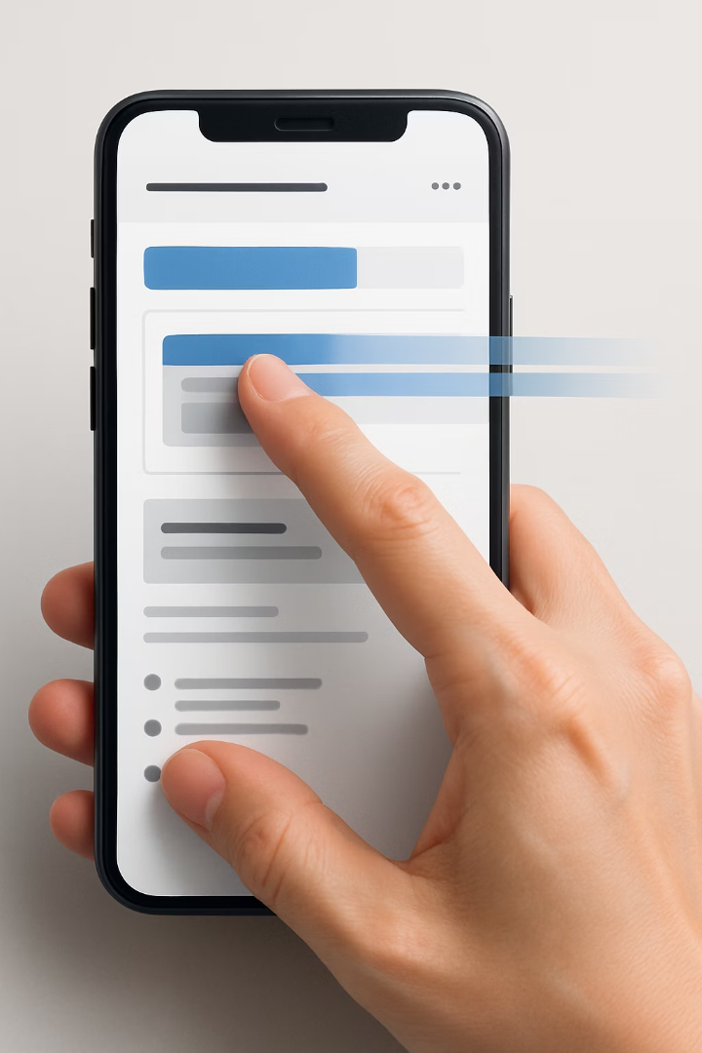
PanResponder for Advanced Gestures
Create PanResponder Instance
Configure gesture handlers using PanResponder.create()
Define callbacks for various gesture states
Attach to Component
Apply panHandlers to component via spread operator
Enables component to respond to complex gestures
Respond to Gesture Events
Access detailed gesture state information
Calculate position changes and apply transformations

Slide 15
Key events with PanResponder
PanResponder provides a comprehensive system for handling complex gesture interactions in React Native applications.
onStartShouldSetPanResponder
onMoveShouldSetPanResponder
Determines whether the component should respond to touch start events. Return true to become the responder.
Called when touch moves on the screen. Return true to claim responder status during movement.
onPanResponderGrant
onPanResponderMove
Touch is recognized. Use this to initialize gesture state values and provide visual feedback.
Touch is moving across the screen. Access gestureState for coordinate changes and velocity data.
onPanResponderRelease
onPanResponderTerminate
User has released touch. Finalize animations and update component state based on the completed gesture.
Responder status has been taken away. Clean up any ongoing gesture effects or animations.

Slide 16
PanResponder Example
import React from 'react';
import { View, Text, StyleSheet, Animated, PanResponder } from 'react-native';
function SwipeableCard({ onDismiss = () => console.log('Card dismissed') }) {
const position = new Animated.ValueXY();
const panResponder = PanResponder.create({
onStartShouldSetPanResponder: () => true,
onPanResponderMove: (e, gesture) => {
position.setValue({ x: gesture.dx, y: 0 }); // only horizontal movement
},
onPanResponderRelease: (e, gesture) => {
if (Math.abs(gesture.dx) > 120) {
// Swipe threshold met - animate off screen
Animated.timing(position, {
toValue: { x: gesture.dx > 0 ? 500 : -500, y: 0 },
duration: 300,
useNativeDriver: true,
}).start(onDismiss);
} else {
// Return to original position
Animated.spring(position, {
toValue: { x: 0, y: 0 },
useNativeDriver: true,
}).start();
}
},
});
return (
<Animated.View style={[styles.card, { transform: position.getTranslateTransform() }]} {...panResponder.panHandlers}>
<Text style={styles.text}>Swipe Me Left or Right</Text>
</Animated.View>
);
}
const styles = StyleSheet.create({
card: {
width: '80%',
height: 150,
backgroundColor: '#ffffff',
borderRadius: 10,
elevation: 4,
justifyContent: 'center',
alignItems: 'center',
alignSelf: 'center',
marginVertical: 20
},
text: {
fontSize: 18,
fontWeight: 'bold',
},
});
export default SwipeableCard;

Slide 17




Understanding Touch Event Data
React Native passes detailed information about touch events through the nativeEvent object. Here's what you can access:
Coordinates
Touch Identifiers
nativeEvent.locationX/Y: Position relative to the touched component (e.g., a button)
nativeEvent.identifier: Unique ID for each finger in multi-touch gestures
nativeEvent.pageX/Y: Absolute position relative to the entire screen
nativeEvent.touches: Array of all current touches on screen
Essential for pinch-to-zoom or multi-finger swipe implementations
Useful for drag-and-drop UI or drawing applications
Pressure Data
Timing
nativeEvent.force: Touch pressure intensity (iOS only)
nativeEvent.timestamp: Millisecond timestamp when touch occurred
Values range from 0.0 (light touch) to 1.0 (maximum pressure)
Calculate gesture duration: endTimestamp - startTimestamp
Can create pressure-sensitive controls like drawing apps
Detect long presses or measure swipe velocity
Access this data in your touch handlers with: (event) => console.log(event.nativeEvent)

Slide 18
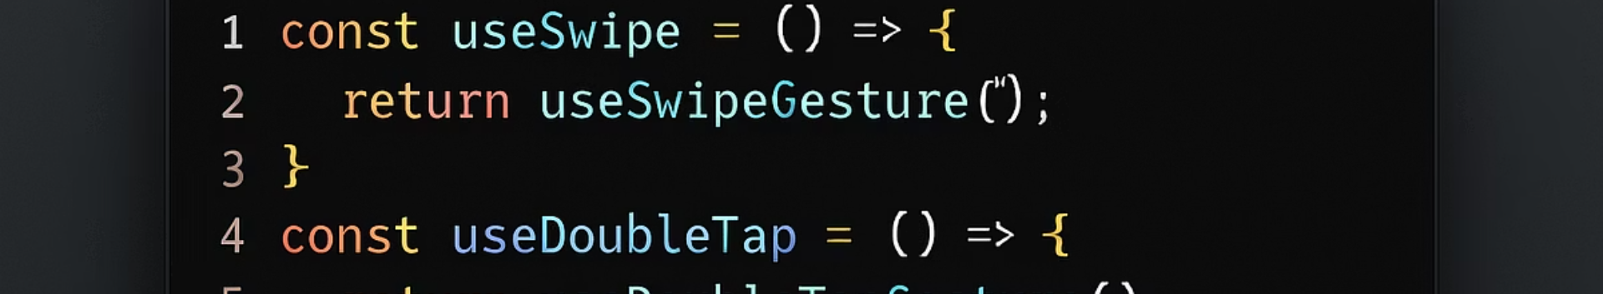
Custom Touch Handling: Community Hooks
Hook Name
Purpose
Example Usage
useSwipe
Detect swipe direction
Swiping items in list
useDoubleTap
Detect double taps
Photo zooming
useLongPress
Detect long presses
Context menus
useDrag
Handle drag gestures
Draggable elements

Slide 19
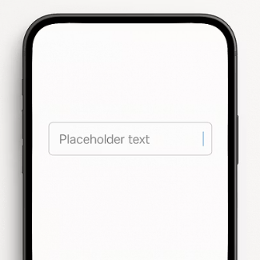
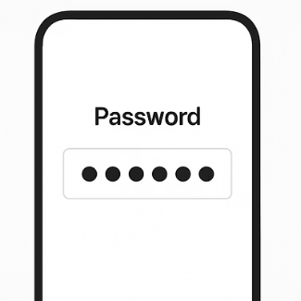
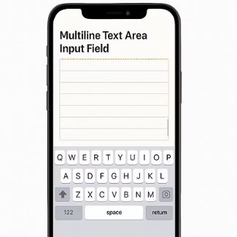
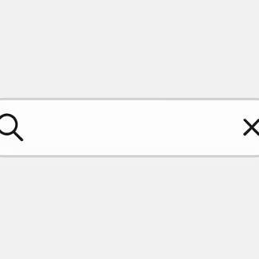
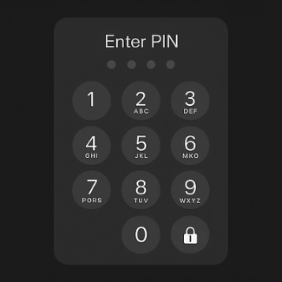
Overview: TextInput in React Native
TextInput is React Native's core component for user text entry. It supports various input types, styling options, and keyboard configurations.

Slide 20
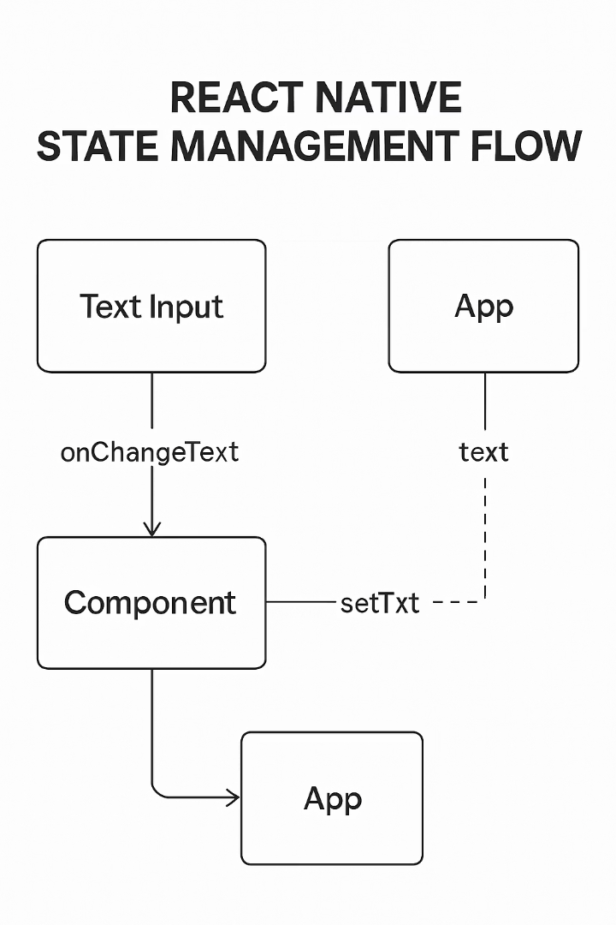

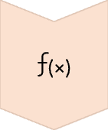

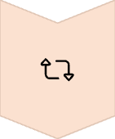
Controlling TextInput: State Management
User Types
Text entered via keyboard
onChangeText Fires
Callback receives new text value
State Updates
useState setter updates component state
Component Re-renders
Input displays updated value

Slide 21
TextInput Example: Controlled Input
const styles = StyleSheet.create({
container: {
flex: 1,
padding: 20,
justifyContent: 'center',
backgroundColor: '#f9f9f9',
},
label: {
fontSize: 16,
marginBottom: 8,
},
input: {
borderColor: '#ccc',
borderWidth: 1,
padding: 10,
borderRadius: 6,
backgroundColor: '#fff',
marginBottom: 20,
},
output: {
fontSize: 16,
color: '#333',
},
});
import React, { useState } from 'react';
import { View, TextInput, Text, StyleSheet } from 'react-native';
const ControlledInputExample = () => {
const [text, setText] = useState('');
return (
<View style={styles.container}>
<Text style={styles.label}>Enter your name:</Text>
<TextInput
style={styles.input}
placeholder="Type here..."
value={text}
onChangeText={setText}
/>
<Text style={styles.output}>You typed: {text}</Text>
</View>
);
};
export default ControlledInputExample;

Slide 22

Handling Keyboard in React Native
KeyboardAvoidingView
ScrollView Integration
Keyboard API
Component that adjusts its height, position, or bottom padding when keyboard appears.
Combine with ScrollView to ensure all form fields remain accessible.
Provides methods and events to programmatically control keyboard.
Uses behavior prop to determine adjustment strategy.
Allows scrolling to fields that would be covered by keyboard.
Use Keyboard.dismiss() to hide keyboard on demand.

Slide 23
Keyboard Dismissal Example
const styles = StyleSheet.create({
container: {
flex: 1,
justifyContent: 'center',
backgroundColor: '#f9f9f9',
},
innerContainer: {
padding: 20,
alignItems: 'center',
},
label: {
fontSize: 16,
marginBottom: 8,
},
input: {
width: '100%',
borderColor: '#ccc',
borderWidth: 1,
padding: 12,
borderRadius: 6,
backgroundColor: '#fff',
marginBottom: 20,
},
output: {
fontSize: 16,
color: '#333',
},
});
import React, { useState } from 'react';
import { View, TextInput, TouchableWithoutFeedback,
Keyboard, KeyboardAvoidingView, Platform, StyleSheet, Text
} from 'react-native';
function KeyboardHandlingScreen() {
const [text, setText] = useState('');
return (
<KeyboardAvoidingView style={styles.container}
behavior={Platform.OS === 'ios' ? 'padding' : 'height'} >
<TouchableWithoutFeedback onPress={() => Keyboard.dismiss()}>
<View style={styles.innerContainer}>
<Text style={styles.label}>Enter your name:</Text>
<TextInput
style={styles.input}
placeholder="Type here..."
value={text}
onChangeText={setText}
/>
<Text style={styles.output}>You typed: {text}</Text>
{/* Rest of your screen content */}
</View>
</TouchableWithoutFeedback>
</KeyboardAvoidingView>
);
}
export default KeyboardHandlingScreen;

Slide 24
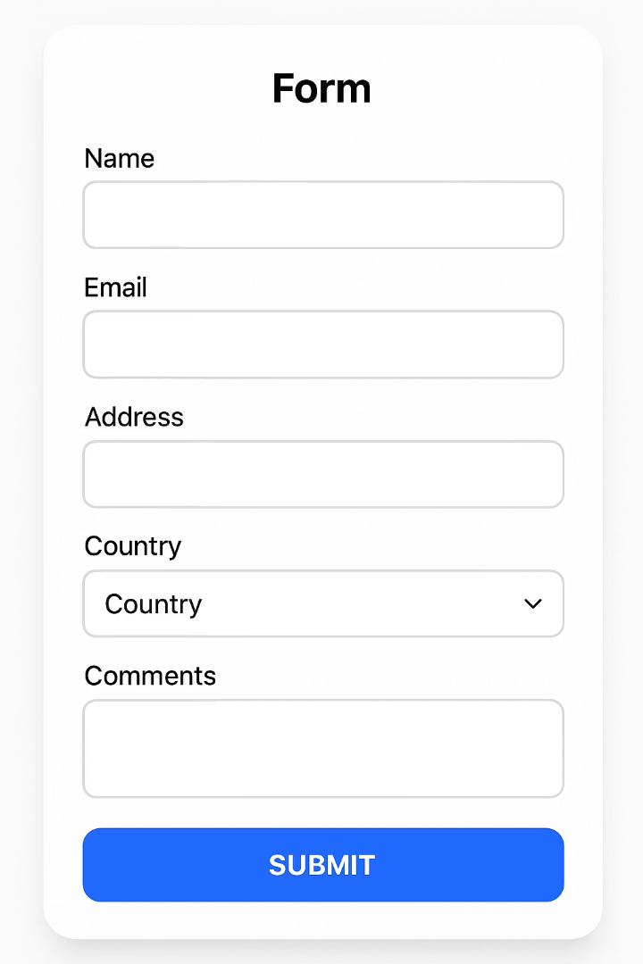
Building Simple Forms in React Native
1
Form Structure
Organize inputs in logical groups with clear labels
2
State Management
Store all field values in a single state object
3
Input Handling
Update specific field values while preserving others
4
Submit Processing
Validate inputs before submitting data

Slide 25
Basic Form Example: Registration
const styles = StyleSheet.create({
container: {
padding: 20,
justifyContent: 'center',
flex: 1,
},
input: {
height: 40,
borderWidth: 1,
borderRadius: 5,
marginBottom: 15,
padding: 10,
fontSize: 16,
},
});
import React, { useState } from 'react';
import { View, TextInput, Button, StyleSheet, Alert } from 'react-native';
function RegistrationForm() {
const [formData, setFormData] = useState({
name: '',
email: '',
password: ''
});
const handleChange = (field, value) => {
setFormData({
...formData,
[field]: value
});
};
const handleSubmit = () => {
// Basic validation
if (!formData.name || !formData.email || !formData.password) {
Alert.alert('Error', 'Please fill in all fields');
return;
}
console.log('Form submitted:', formData);
Alert.alert('Success', 'Registration successful!');
};
return (
<View style={styles.container}>
<TextInput
style={styles.input}
placeholder="Enter your name"
value={formData.name}
onChangeText={(text) => handleChange('name', text)}
/>
<TextInput
style={styles.input}
placeholder="Enter your email"
value={formData.email}
onChangeText={(text) => handleChange('email', text)}
keyboardType="email-address"
autoCapitalize="none"
/>
<TextInput
style={styles.input}
placeholder="Enter your password"
value={formData.password}
onChangeText={(text) => handleChange('password', text)}
secureTextEntry
/>
<Button title="Register" onPress={handleSubmit} />
</View>
);
}
export default RegistrationForm;

Slide 26





Validating Forms: Why Validation Matters
Security
Data Integrity
User Experience
Reduced Server Load
Prevents malicious data entry. Protects your application and backend from unexpected inputs.
Ensures stored information is correct. Prevents database corruption from invalid formats.
Provides immediate feedback. Guides users toward successful form completion.
Catches errors client-side. Minimizes unnecessary network requests with invalid data.

Slide 27
Popular Validation Libraries: Formik and Yup
Formik
Yup
Handles form state management
Schema-based validation
Tracks touched fields
Declarative approach
Manages error messages
Type validation
Handles form submission
Custom error messages
Reduces boilerplate code
Easy integration with Formik
Installation
Installation
npm install formik
# or
yarn add formik
npm install yup
# or
yarn add yup

Slide 28




Introduction to Formik
Form Setup
Input Management
Define initial values, validation schema, and submit handler
Connect fields to Formik using handleChange and handleBlur
Submission
Error Handling
Process validated data with handleSubmit and resetForm
Display validation errors from errors object when fields are touched

Slide 29
Starting with Formik: Example
Implementation
function LoginForm() {
return (
<Formik initialValues={{ email: '', password: '' }}
onSubmit={(values) => {console.log('Form submitted with:', values);}}>
{({ handleChange, handleBlur, handleSubmit, values }) => (
<View style={styles.container}>
<TextInput
style={styles.input}
onChangeText={handleChange('email')}
onBlur={handleBlur('email')}
value={values.email}
placeholder="Email"
keyboardType="email-address"
/>
<TextInput
style={styles.input}
onChangeText={handleChange('password')}
onBlur={handleBlur('password')}
value={values.password}
placeholder="Password"
secureTextEntry
/>
<Button onPress={handleSubmit} title="Login" />
</View>
)}
</Formik>
);
}
Formik simplifies form state management by handling values, errors, and submission in one component.
The initialValues prop sets starting field values while validationSchema (added later with Yup) handles validation.
Destructured props like handleChange, handleBlur, and handleSubmit connect your form elements to Formik's state management system.
import React from 'react';
import { View, TextInput, Button, Text, StyleSheet } from 'react-native';
import { Formik } from 'formik';

Slide 30
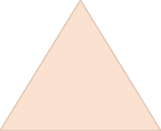







Introduction to Yup
Complete Validation
Combine rules for comprehensive validation
Chained Methods
Build validation rules with method chaining
Type Validation
Define expected data types (string, number, etc.)
Schema Definition
Create reusable validation schemas

Slide 31
Yup Validation Example
Schema Structure
import * as Yup from 'yup';
// Registration form validation schema
const RegistrationSchema = Yup.object().shape({
name: Yup.string()
.min(2, 'Name is too short')
.max(50, 'Name is too long')
.required('Name is required'),
email: Yup.string()
.email('Invalid email address')
.required('Email is required'),
password: Yup.string()
.min(8, 'Password must be at least 8 characters')
.matches(
/^(?=.*[a-z])(?=.*[A-Z])(?=.*\d)(?=.*[@$!%*?&])[A-Za-z\d@$!%*?&]{8,}$/,
'Password must contain uppercase, lowercase, number and special character'
)
.required('Password is required'),
confirmPassword: Yup.string()
.oneOf([Yup.ref('password'), null], 'Passwords must match')
.required('Confirm password is required')
});
Define validation rules for each field using Yup's schema API.
Chain validation methods to apply multiple rules to a single field.
Custom error messages make validation feedback more user-friendly.
import * as Yup from 'yup';
// Login form validation schema
const LoginSchema = Yup.object().shape({
email: Yup.string()
.email('Invalid email address')
.required('Email is required'),
password: Yup.string()
.min(8, 'Password must be at least 8 characters')
.required('Password is required')
});

Slide 32
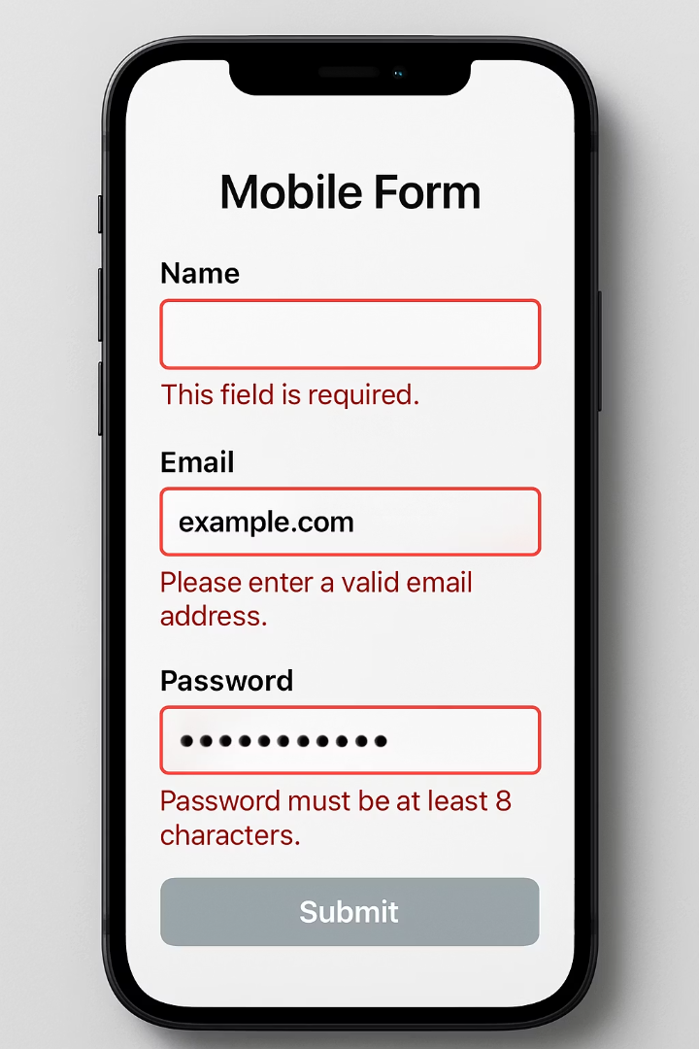




Formik + Yup Integration
Link Yup Schema to Formik
Add validationSchema prop to Formik component
Automatic Validation
Formik uses schema to validate on change, blur, and submit
Access Error Messages
Errors object contains validation messages for each field
Display Feedback
Render error messages when field is touched and invalid

Slide 33
Complete Formik + Yup Example
Features
const FormikRegistrationForm = () => { return ( <Formik initialValues={{ name: '', email: '', password: '' }} validationSchema={validationSchema} onSubmit={(values) => { console.log('Form Data:', values); Alert.alert('Success', 'Form submitted successfully!'); }} > {({ handleChange, handleBlur, handleSubmit, values, errors, touched }) => ( <View style={styles.container}> {/* Name Input */} <TextInput style={styles.input} placeholder="Name" onChangeText={handleChange('name')} onBlur={handleBlur('name')} value={values.name} /> {touched.name && errors.name && <Text style={styles.error}>{errors.name}</Text>}
Real-time field validation with error messages from Yup schema
Conditional error display only after field interaction (using touched state)
Form submission control based on validation status
Visual feedback with styled components based on validation state
Complete integration between form state and UI elements
This example demonstrates a practical registration form implementation that combines all concepts from previous slides.
import React from 'react';
import { View, TextInput, Button, Text, StyleSheet, Alert } from 'react-native';
import { Formik } from 'formik';
import * as Yup from 'yup';
// Validation schema using Yup
const validationSchema = Yup.object().shape({
name: Yup.string().required('Name is required'),
email: Yup.string().email('Invalid email').required('Email is required'),
password: Yup.string().min(6, 'Min 6 characters').required('Password is required'),
});

Slide 34
{/* Email Input */}
<TextInput
style={styles.input}
placeholder="Email"
keyboardType="email-address"
autoCapitalize="none"
onChangeText={handleChange('email')}
onBlur={handleBlur('email')}
value={values.email}
/>
{touched.email && errors.email && <Text style={styles.error}>{errors.email}</Text>}
{/* Password Input */}
<TextInput
style={styles.input}
placeholder="Password"
secureTextEntry
onChangeText={handleChange('password')}
onBlur={handleBlur('password')}
value={values.password}
/>
{touched.password && errors.password && <Text style={styles.error}>{errors.password}</Text>}
{/* Submit Button */}
<Button title="Register" onPress={handleSubmit} />
</View>
)}
</Formik>
);
};
const styles = StyleSheet.create({
container: {
padding: 20,
justifyContent: 'center',
flex: 1,
},
input: {
borderWidth: 1,
borderColor: '#ccc',
padding: 12,
borderRadius: 6,
marginBottom: 10,
backgroundColor: '#fff',
},
error: {
color: 'red',
marginBottom: 10,
},
});
export default FormikRegistrationForm;

Slide 35
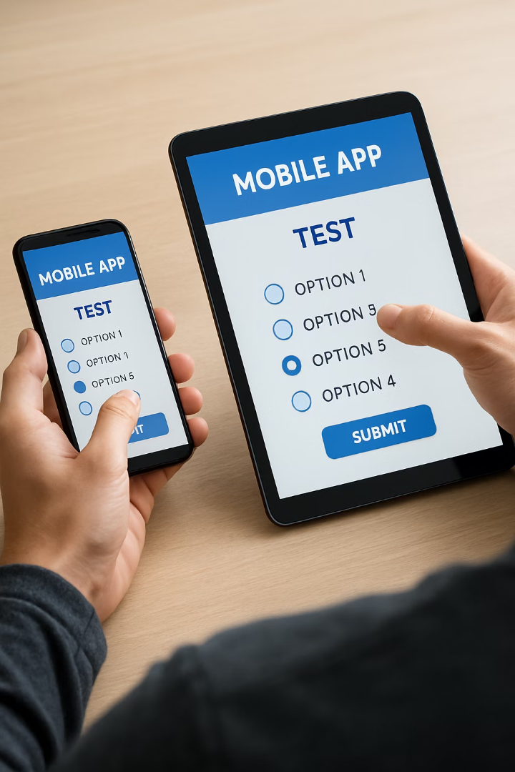




Tips for Beginners with Touch & Forms
Test Across Devices
Touch behavior and keyboard handling vary between iOS and Android. Test on real devices.
Accessibility Matters
Use appropriate touch targets (44x44 points). Add accessible labels to all interactive elements.
Provide Visual Feedback
Always show users their actions have been recognized. Add loading states during submission.
Optimize Keyboard Flow
Set proper keyboard types. Use returnKeyType and blurOnSubmit to improve input flow.

Slide 36
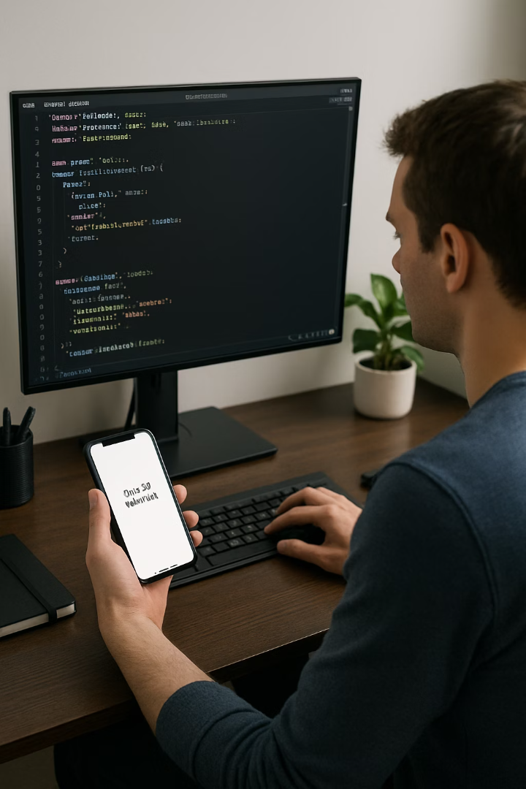
Summary & Next Steps
Master the Basics
Practice implementing different Touchable components and TextInput forms.
Experiment with form validation using both manual methods and Formik+Yup.
Build Example Projects
Create a login/registration flow with validation.
Implement a gesture-based UI like swipeable cards or draggable elements.
Explore Advanced Topics
Dive into the Animated API for advanced touch interactions.
Learn about accessibility features for touch and form elements.

